Slide 1
Automated Energy Optimization of HTTP Requests for Mobile Applications Ding Li, Yingjun Lyu, Jiaping Gui, & William G. J. Halfond
PRESENTED BY: NISHTHA CHAWLA

Slide 2
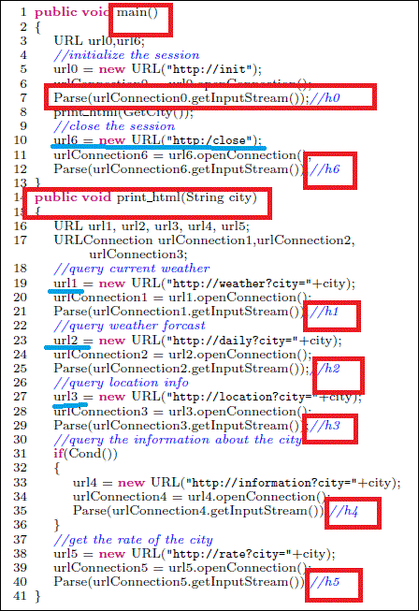
Problem
Multiple HTTP requests
Issues:
Tail energy
Multiple headers in Packets
Multimessage handshake protocols!
Figure : 1

Slide 3

BACKGROUND WHY FOCUS ON HTTP REQUESTS?
HTTP request- Energy Greedy!
Example:
Energy(1 byte data via HTTP)= Energy (1000 byte data via HTTP)=E
Energy(10000 byte data via HTTP)= 2*E
Data 10 times vs Energy 2 times!

Slide 4
MOTIVATION
SMARTphones but not so smart battery life!
Usability gets limited!
Aim: to reduce app’s energy consumption
Inspiration: Bundling HTTP implemented in Web Browser!

Slide 5

APPROACH
AIM: Energy optimization of HTTP request in Android apps
How?
GOAL: Reduce the number of HTTP requests by an app
What to Do: Detect→ Bundle→ Optimize
How to Do: Analysis→ Generate Code → Proxy
Implementation: As a tool named Bouquet
Fancy Terms:
SHRSs: Sequential HTTP Request sessions (h1→h2→h3)
AHA: Agent HTTP API
AUT: Application Under Test
AUT’: Optimized application

Slide 6
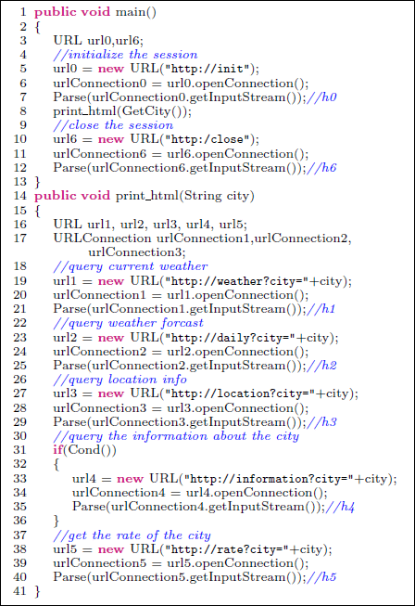
EXAMPLE
Sample Code
Entry→h1→h2→h3
h3→h4 or h5
h5→exit(main)
Figure 2:

Slide 7
TECHNIQUE PHASE 1 – Sequential HTTP Request Session Detection
Input: method ‘m’ of applications
Output Tm= set of SHRS in ‘m’
Technique : Static Analysis
Static analysis
Intra Procedural
Inter Procedural
Block M post dominates block N if every path from N to the exit has to pass through block M.

Slide 8
Intra Procedural Analysis
EXIT
1. Generate post dominator tree - P.
2. Extract a projection P’ where nodes= HTTP API Call
3. Analyse P’ to find SHRS.
4. SHRS = Maximal Node sequence without branch.
Output <h1,h2,h3>, <h4>, <h5>
h5
h4
h3
h2
h1
FIGURE: P’
ENTRY

Slide 9
EXAMPLE
Sample Code
Entry→h1→h2→h3
h3→h4 or h5
h5→exit(main)

Slide 10
Inter Procedural Analysis
h0
Generate P’’ sub tree using P’
Identify all SHRS from P’ which post dominate entry node.
Analysis Path: entry to exit
Final (h0- SHRS1), (SHRS3-h6)
Expand summary node
<h0, h1,h2,h3>, <h5, h6>
SHRS1
<h1,h2,h3>
SHRS3
<h5>
h6

Slide 11
TECHNIQUE PHASE 2 - BUNDLING ANALYSIS
Input to Analyzer = AUT + SHRS
Output from Analyzer= Bundler for each SHRS
Bundler Components= Tester + Operator
Tester = Regular expression pattern that match the URL of first http request
Operator = Decides the HTTP requests whose responses are to be bundled
Analyzer Role:
Rewrite HTTP API call
Analyze argument information to HTTP call to generate Bundler

Slide 12
TECHNIQUE PHASE 2 - BUNDLING ANALYSIS
HTTP Request=<target URL,Header,Parameter>
Step 1: String Analysis. Find value of request variables.
Step 2: Replace HTTP API call by Agent HTTP API invocation. Add CSID to same parameters.
Step 3: Generate Tester. Recognizes incoming request by solving string values
Step 4: Operator. Finds values for remaining requests in SHRS & Generates Bundling Code

Slide 13
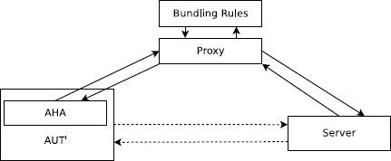
TECHNIQUE PHASE 3 - RUNTIME OPTIMIZATION
RUNTIME!
AUT’ executed
AHA inserted to AUT’
Requests redirected to Proxy
Proxy uses Bundlers
Proxy receives responses
Proxy Bundles responses and sends to AHA
AHA unpacks and distributes responses
Figure 3 : Workflow

Slide 14
TECHNIQUE PHASE 3 - RUNTIME OPTIMIZATION
Receives
request
PROXY
URL + CSID
from request’s header
TESTER
Bundles responses
Yes, 1st of
SHRS
Sends to AHA
Identifies responses to be bundled
OPERATOR
Identifies request information(URL & parameters)
Response to proxy
APP SERVER
Requests in sequence to server

Slide 15
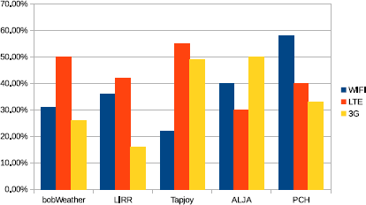
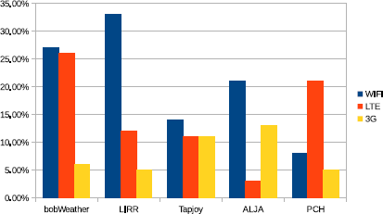
RESULTS-RQ1-EnergySavings
Network Simulator: NEWT(Network Emulator for Windows Toolkit)
Energy collection via vLens + Monsoon
Execution count = 5 times
HTTP Request size- 1-3 kB
Energy savings:
Figure 4: SHRS LEVEL
 | WIFI | LTE | 3G
Whole App | 21% | 15% | 8%
SHRS level | 37% | 43% | 35%
Figure 5: WHOLE APP LEVEL

Slide 16
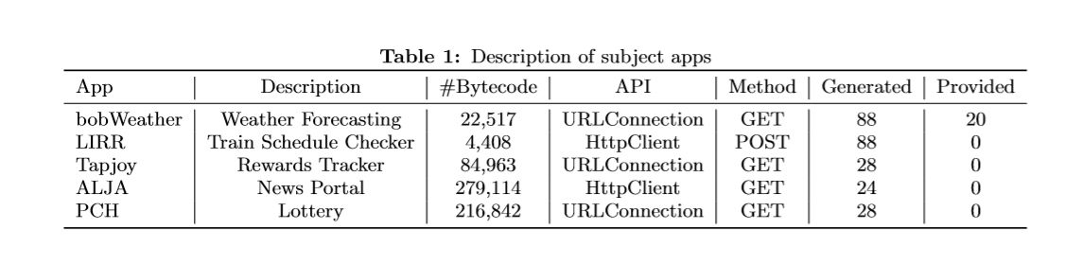
RESULTS- RQ2- Manual Effort
AVG = 51
Effort: To modify generated code for proxy
App 1: String values of URL of API call – Branches
Manual intervention-to complete generated code
Figure 6
5 apps, 2 common HTTP API & 2 common methods
Manual Effort – Measuring by LOC. How to account for expertise/domain skills/time?

Slide 17
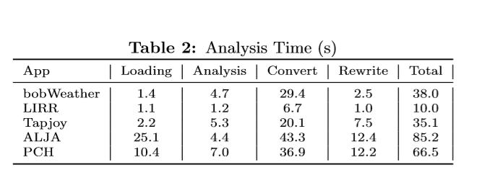
RESULTS- RQ3- Analysis Time
AVG =47
Evaluated: Time taken by bouquet (detect SHRS & generate AUT’ & Bundler)
Measured: Execution time of each phase
All Test case instrumentation< 1.5 minutes
Figure 7(time in seconds)
Analysis= to detect SHRS+ create bundling rules
Convert= Dalvik to java bytecode
Rewrite=Replace API by AHA

Slide 18
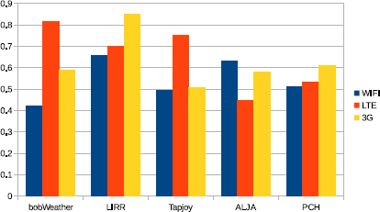
RESULTS- RQ4 – Runtime Overhead
AHA – Pack & unpack bundled response
Reported Ratio =
(a)Total HTTP response time of SHRS in AUT’/
(b)Total HTTP API call response time in orig
All ratios less than 1.
A= 61% of B
Average Standard Deviation=13%
Bundled requests→ less requests to be sent→ less time to get response
Figure 8: Runtime Overhead

Slide 19

RESULTS- RQ5 - Pervasiveness
7878 Market apps from Google Play Market
23 different categories
Varied sizes – 100 bytes to 50MB
206 out of 7878 apps had SHRS ~ 2.6%
Some apps- 0 or 1 HTTP API call so no SHRS
SHRS presence increased to 4.2%
Projection: Total Google Play apps(1.6 mil)
2.6% of 1.6 mil = 40,000 Possibilities!!

Slide 20

STRENGTHS
No new protocol or language needed
Independent of system infrastructure
Saved time in network transmission
Usable & Scalable technique

Slide 21

WEAKNESS
Analyzer can not predict which branches would be taken at runtime – No Bundling Code created
Handles only few types of HTTP requests
Developer interaction: to confirm identified optimizations

Slide 22
CONCLUSION
Addresses general issue but attempts a different approach
Targets an important area of HTTP
Energy Savings of 15%

Slide 23

HTTP Bundles
Mobile Apps
ENERGY
Agent HTTP API
Sequential HTTP Requests

